Slide 1
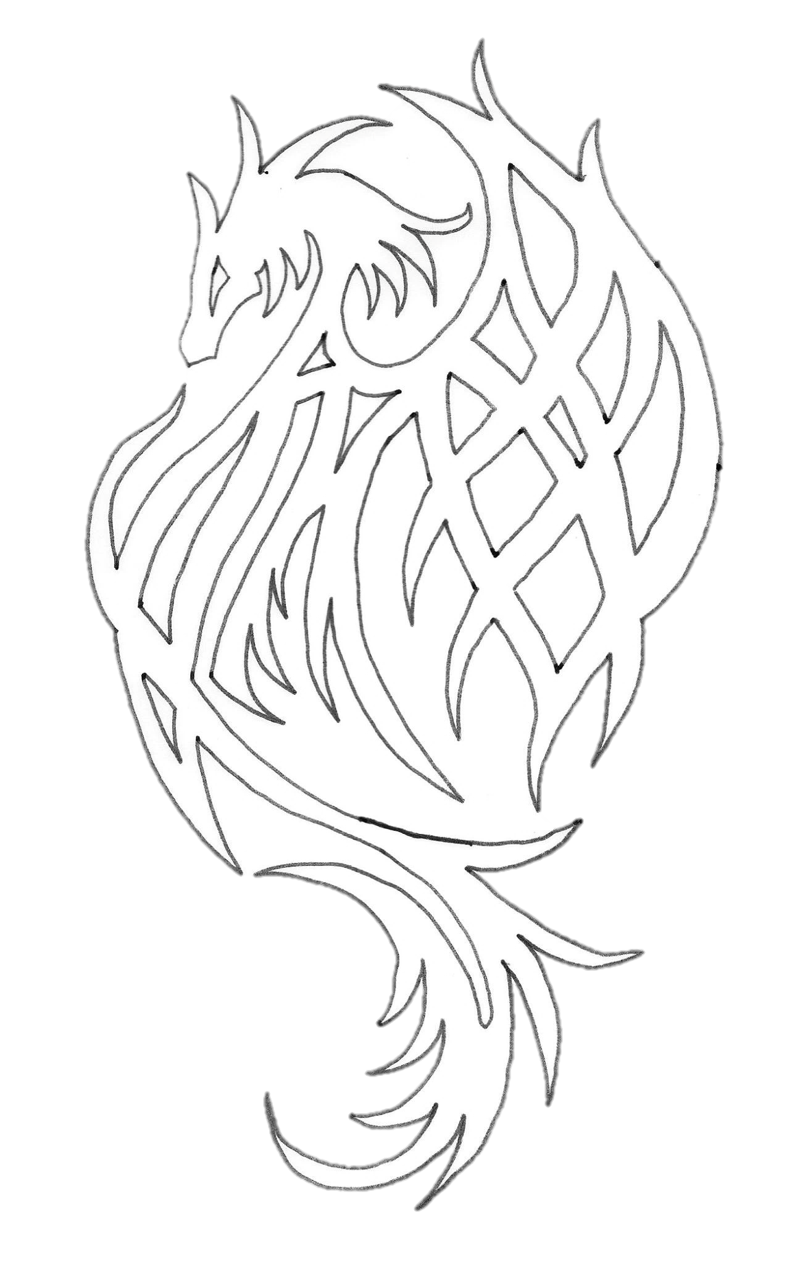
The Jhereg
The Jhereg are a people drawn together by their shared belief in the unity of the nation and an entity known as the Jhereg Spirit.
The hostile land of Siberia is where the Jhereg make their home, from deadly marshes to vast unforgiving deserts the Jhereg people not only survive but prosper. Ever the great mix of societies, Siberia can boast of both great city-states and thriving tribal civilisations.
The Jhereg Empire believes in the ‘Great Freedom,’ where no race, religion or belief is persecuted and will go to any length to protect their own, to be Jhereg is to never be alone.
Powerful wizards ply their trade across the land, divining great mysteries and unlocking the workings of the arcane, or creating items of power to bolster the warhost; beast creatures come to the call of the Jhereg spirit, strength and ferocity in their hearts; standing beside proud soldiers from the many cities who come to guard the warhost; their fighting forces bolstered by potions and skillfully crafted tools of war.
Clever traders collate vast wealth and expand their treasuries with strange magical items, while diplomats make peace with the nations around them who often misunderstand the Jhereg ways.
Though sometimes mistrusted by others, the Jhereg are at the forefront of any fight against a threat to civilization, be it aligning with mystical forces, wielding powerful magics or cavorting with dark entities, the Jhereg will use whatever means are at their disposal to win the day

Slide 2
The Jhereg Spirit
Being made up of such diverse and varied people, the Jhereg Empire does not have one set religion. All groups and cultures are free to worship their own gods and spirits in their own way. The one thing that is set in stone within Siberia is the belief in the Jhereg Spirit.
The Jhereg Spirit is an entity made up of the will of all the living and the spirits of all the dead Jhereg. Even though many people within Siberia will worship or believe in other gods as well, at least part of them will join with the Jhereg Spirit when they die, thus strengthening the Spirit and the nation.
When the previous ruler of Siberia died in Kol Kathrak, the people of the Jhereg were unsure of what leadership they needed. It is for this reason that the Jhereg Spirit took three vessels and created the Taken. Liv Loneye became Intrigue, Wyatt of Norovik became Carnage and Draka became Rapture. The Jhereg Empire is now ruled by these three embodiments of the Jhereg Spirit. Unlike the gods of the Fir Cruthen and Wolves, the Jhereg Spirit very rarely walks the earth although from time to time you may meet an embodiment of it.
To enable everyone to worship in their own way the Jhereg as a whole believe in something called the Great Freedom. This is a freedom extended to all and a guarantee that nobody will be persecuted for their beliefs.
One group within Siberia who dedicate their lives to the worship of the Jhereg Spirit are the Cult of Vestis, comprising both a martial arm (The Talons) and a spiritual arm (Priesthood) they are devoted to the empowerment and education of the people of Siberia in the ways of the Jhereg Spirit.
Another faith based on the Jhereg Spirit is the Church of the One, they believe in striving to do the best for the Jhereg with what you have, emphasising personal commitment to the ideals of the Jhereg and taking responsibility for trying to solve problems that ail the Empire. Through devoting all you are and all you do to the Jhereg Spirit they believe you strengthen the spirit and thus the nation.

Slide 3
Jhereg Outlook
Throughout history the allied factions have fought many enemies and hard choices have had to be made to defeat them. At the forefront of all these difficult choices have been the Jhereg.
It is because of this willingness to make hard choices that the Jhereg have learnt more than most about the more controversial and interesting creatures that inhabit the world. The people of Siberia have also learnt that the best way to destroy your enemy is to ensure you know everything about them which is why you will find that many Jhereg will talk to their enemies and investigate their weaknesses rather than engaging in a losing battle.
Due to the diverse and varied nature of the Jhereg Empire the most important aspect of life in Siberia is unity. It is the unity amongst the diverse peoples within Siberia that gives the Jhereg its strength.
The diversity within the faction has allowed the Jhereg to become truly adaptable. It is also why everyone in the Jhereg is judged by their own actions and not because of association, or because of their race or origins.
Whilst many factions will look upon undead/demons/other creatures with fear and judgement, the people of the Jhereg will look to the actions of those they deal with and only then make a judgement on who to call enemy.

Slide 4
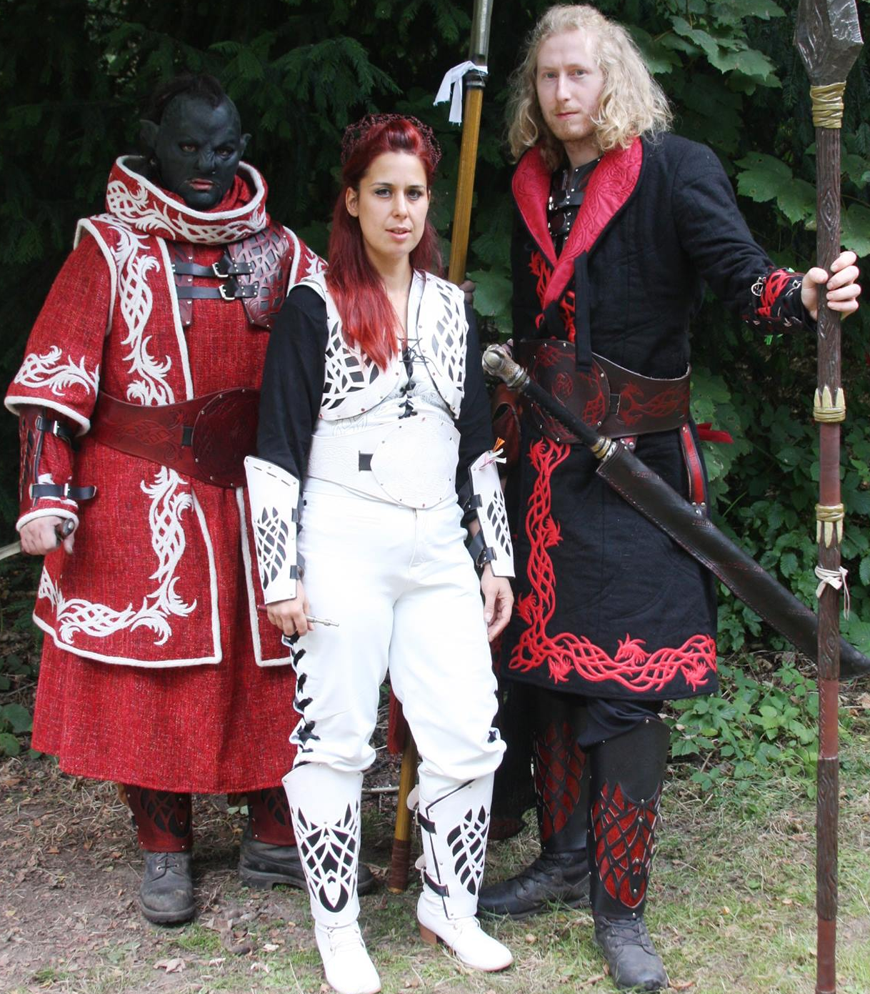
Ranks and Structures of the Jhereg Warhost
The Taken
The Taken are three physical manifestations of the Jhereg Spirit. Each of them represent a different aspect of the Jhereg Spirit and govern one of three orders. Each of these orders are made up of Chosen and their Trialed.
Intrigue – Taken of Rule
Carnage – Taken of War
Rapture – Taken of Power
Order of Rule
Inquisition
Faction Relations
Trade and Warchest
Negotiations
Order of War
War
Scouting
The Watch
Order of Power
Conjoined Magics
Magical Resource
Operating outside of these orders are the Triumphants. These are specially selected members of the Jhereg warhost with a remit that potentially spans all of the different Orders.

Slide 5
Regions of Siberia
North
From the frozen islands far to the north to the rolling grasslands of the Central Siberian plains. This region of Siberia perhaps demonstrates best the diverse struggles the people of the Jhereg nation face to simply survive. While there are wealthy cities like Norovik and places of stunning beauty like the Lakes region most of the north of Siberia is quite inhospitable to most. Maybe this is why the hardy people of the Llyth Wan Noss (Once the Bar Llyr) and the Orcish tribes of the once King Karamassa, amongst others, seem to flourish.
South
Most who flourish in the south of Siberia tend to be nomadic or tribal peoples living either by their quick wits, the wisdom of many generations or a combination of both. The regions of South Siberia range from the seemingly endless Great Forest home of the Goblin Horde and the M’benga Goblins to sun scorched desert sands and towering mountain ranges. It is from the south that many tribes and packs of beastmen and wild elves hail. Although there are plenty of nomadic humans in the area, they tend to steer clear of the tribal hunting grounds as misunderstandings have been often known to happen. There are far fewer great cities in the South but most famous among them is Red Rock. Once a warzone between the traditional tribal nature of the Lakota and the more progressive humans of the area, Red Rock is now a thriving city where the best of many cultures can be found.
In the desolate sands of Southern Siberia can be found the rubble of what was once a major city and became the ruined city of Kol Kathrak. It is here that the previous avatar of the Jhereg Spirit was devoured by the god Malum who was in turn destroyed.
East
Eastern Siberia is a thriving and bustling place of trading cities and it is here that the largest population of humans calls home. Eastern Siberia is also where the Capitol city of Siberia is located. An island city in the centre of a small inland sea, Port Reybard is the central hub of government housing the Glass Palace, residence of previously Lord Jhereg and now Intrigue.
Eastern Siberia is also where the Island of Nexis is located. Both a nexus of ritual magic and once the base of the Cult of Vestis, Nexis has had a colourful history. Currently lost to the forces of Inducu, Nexis also houses what was once a fortified prison known as The Tombs.

Slide 6
West
Once a thriving and vibrant part of Siberia, the west has borne the brunt of many wars and the turmoil they create. The 1104 treaty with the Imperials also cut deeply into this region. A large part of this region has been covered for centuries in the Fae forest known as Vallistanor. Until the great Renewal of 1116 where the Jhereg with the backing of the forces of the Pact Mundi finally razed Nendya city to the ground and once and for all dealt a fatal blow to the Vallista fae who had caused so much turmoil in our history.
Major Cities
Port Reybard – Capitol City of Siberia and home to the Glass Palace and Ruling seat of Intrigue.
Port Reybard is a city heavily geared towards trade and whilst it is the Capitol this is a place where the law can be bent and even bought with the right licence and fee.
Nexis - A magical Nexis of ritual magic. Nexis was once the seat of the Elders of the Cult of Vestis. However it has become an inhospitable place to true Jhereg in recent years, first with the rise and fall of Lady Nexis, then the conflict between the Church of the One and the Cult of Vestis and recently the overthrow of the fortified prison called the Tombs.
Norovik - The largest city in Northern Siberia is a trading hub that has been rebuilt to its former glory over the last decade. Norovik was the location of the final battle between the allied factions and the Demon Gabriel and as such was destroyed in the fighting.
Nova Jorvik – The new home of the Company of Merchant Adventurers, build after their old city Eboracum was reclaimed by the hugely powerful black dragon that declared it as its own. Nova Jorvik is a new city but a thriving one in the Weast of Siberia
Red Rock – This is a city that did not exist ten years ago and started as a trading post between the traditional tribal beastmen of the Lakota and the more forward thinking humans of Southern Siberia. Through the work of King Stone Fur, this has become a prosperous and thriving place where murder and suspicion have given way to trade and learning for all.
Mallegrad - A large trading city in the East of Siberia, Mallegrad is most famous amongst the warhost for being the place the Vile were first discovered. These hardworking folk from under the ground were at first feared by the Jhereg but have since become an integral part of Mallegrads manufacturing community
Kara - A port city on the Northern coast of Siberia, Kara has been a major trading city for a long time but has recently also been a staging post in the efforts to reclaim the frozen lands of the Northern Alliance.

Slide 7
Well Known Phrases
There are a number of things you will regularly hear in the Jhereg camp of which everyone in Siberia would be aware. These calls and answers stem from the fact that our strength is our unity.
“What is your name?”
Is answered with
“JHEREG!”
You will also hear
“When one Jhereg calls”
“All Jhereg Answer!”
Jhereg Ref Team
Faction Command
1IC – Intrigue – Sarah Partridge
2IC – Carnage – Tom Bradford
3IC – Rapture – Luke Dickin
Faction Refs
Alex Grant
James Littlewood
Tam Hatton - Brown
Peter Mooney
Billy Fowler

